Slide 1





Exploring ChatGPT as a Recommender System
Peyman Naseri
NLP project
Fall 02-03

Slide 2

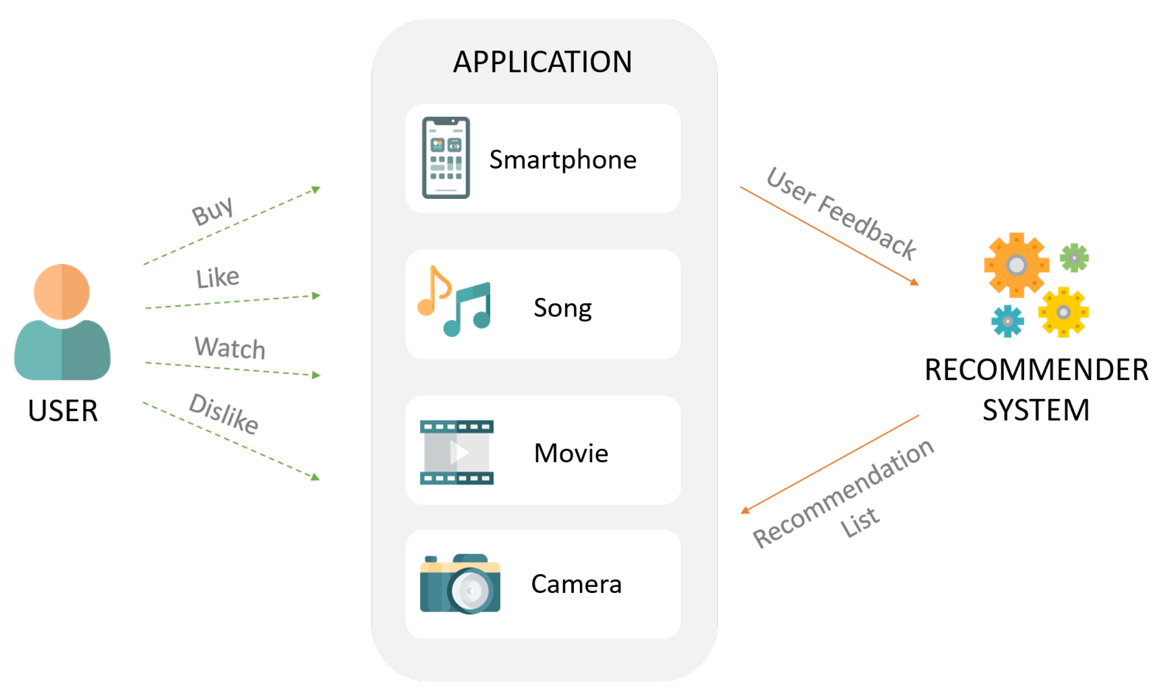

Recommender system ?

Slide 3
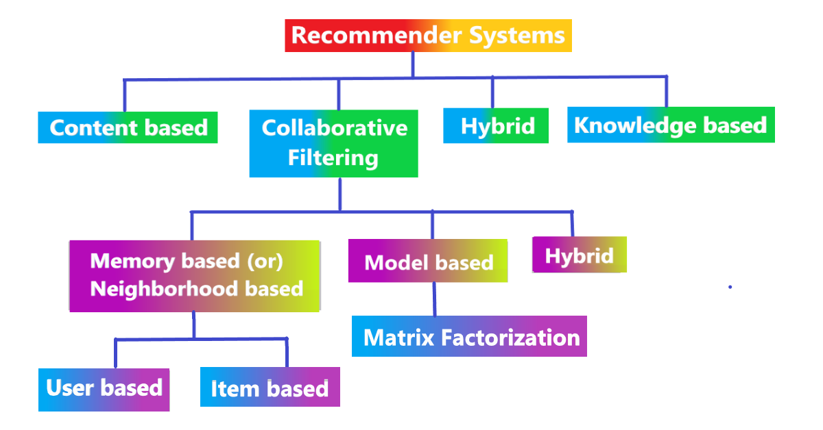

Type of recommender system

Slide 4
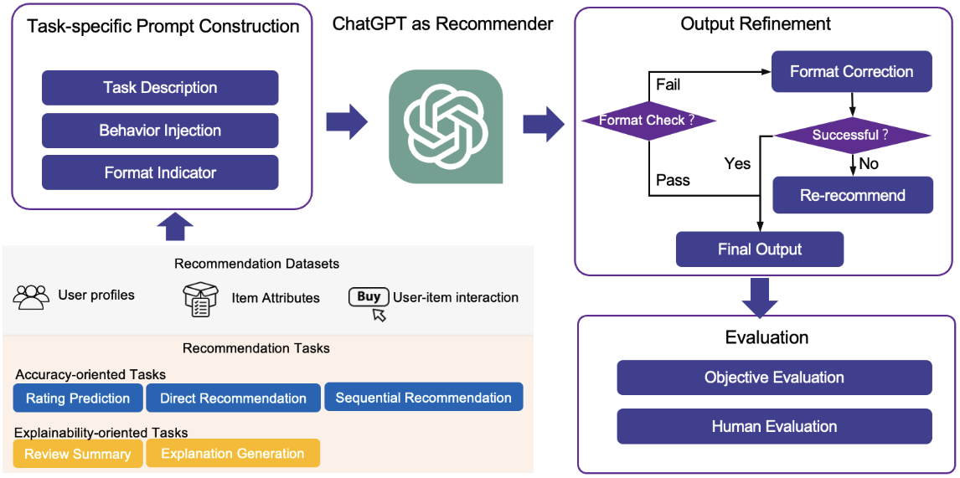
Knowledge based

Slide 5
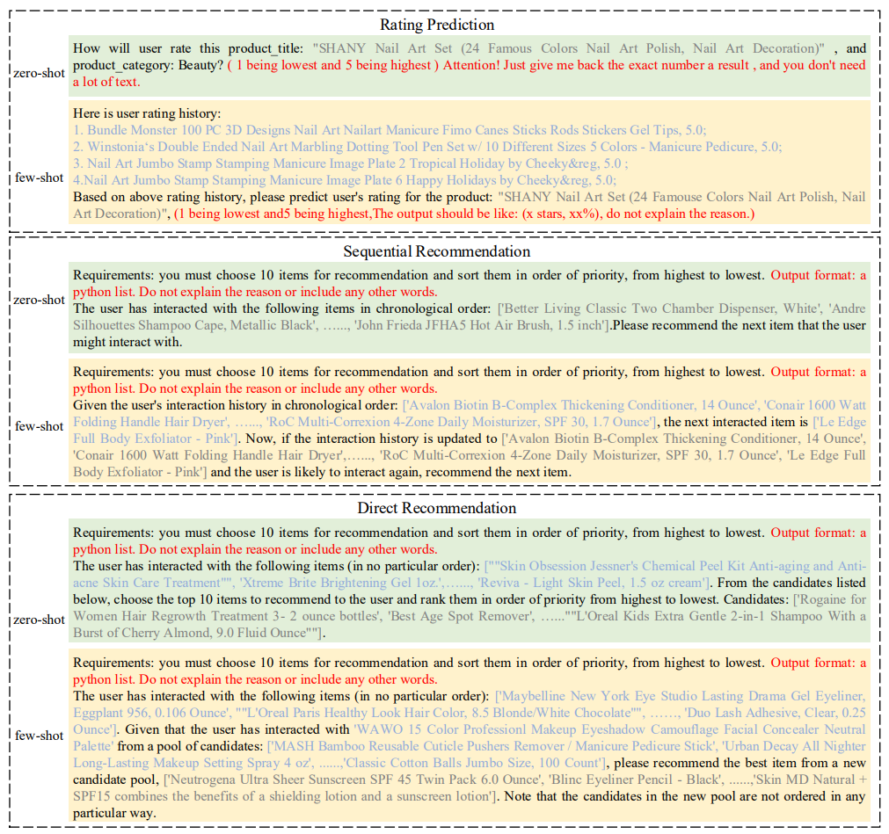

Recommendation Tasks
• Total Prompts Created: Approximately 700,000
• Prompts Used for Evaluation:
ChatGPT: 3,000 (500 per task for both zero-shot and few-shot modes)
LLAMA: 60 (due to lower performance, indicating less utility in further evaluations)

Slide 6
Evaluation
Input size limit
Similarity vs transaction
Rating prediction
Sequential recommendation
Direct recommendation
Notes:
انگار فوکوس مدل روی کانتنت هست تا تراکنش ها در واقع مدل فقط سیملیاریتی میسنجه

Slide 7


LLAMA
Pre-train
Ineffectual answers
Fine-tune
Hardware Limitations
Computational Costs

Slide 8
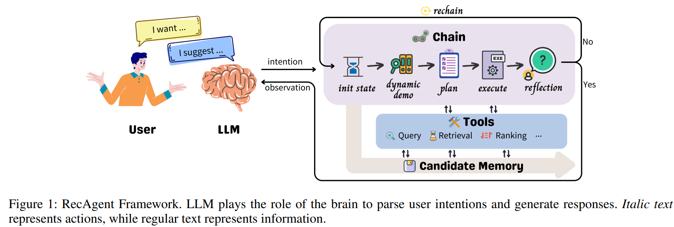
Conclusion

